Slide 1
System Analysis and Design on Institute of Information & Communication Technology, CUET
Submitted By :
Shafiul Alam (1904006) Md. Akib Hasan (1904015)
K.M Mahabub Hossain (1904017)
Sadman Rahman Ananta (1904020)
Sawmik Kumar Paul (1904021)
Supervised By:
Prof. Dr. Kaushik Deb Professor, Dept of CSE, CUET Sabiha Anan Assistant Professor, Dept of CSE, CUET
1
Notes:
1
*

Slide 2
Contents
Introduction
Objectives
Types of Feasibility Analysis
Limitations of Current System
Proposed Systems
Feasibility Analysis of Current Registration System
Feasibility Analysis of WIFI System
Comparison
Conclusion

Slide 3
Introduction
Feasibility analysis
Detailed evaluation of current system
Investment
Benefit to users
Return on investment
Proposals
Comparison and recommendation

Slide 4
Objectives
To understand the technical, operational and economical feasibility of proposed solution
To determine whether the project is viable, practical and worth pursuing
To calculate the payback period

Slide 5
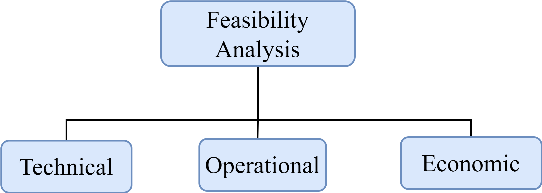
Types Of Feasibility Analysis
Fig 01: Types of feasibility analysis

Slide 6
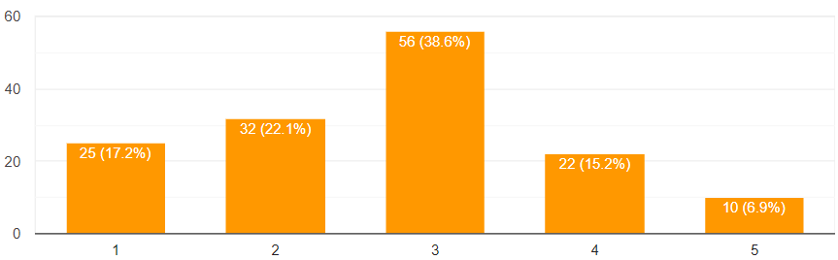
Limitations Of Current Registration System
Couldn’t meet users’ satisfaction upper than average level
Fig 02: User satisfaction on current registration service

Slide 7
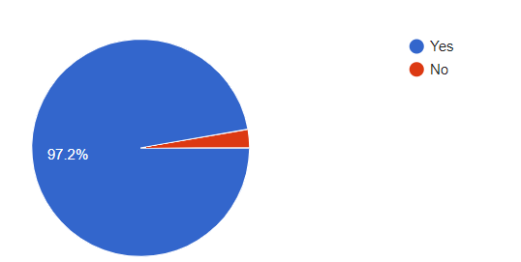
Limitations Of Current Registration System(Contd…)
Users want multiple payment gateways
Fig 03: User response on introducing multiple payment gateways

Slide 8
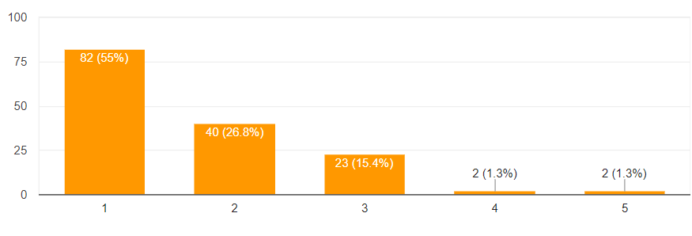
Limitations Of Wi-Fi System
Users’ disappointment on Wi-Fi system
Fig 04: User response on using Wi-Fi system

Slide 9
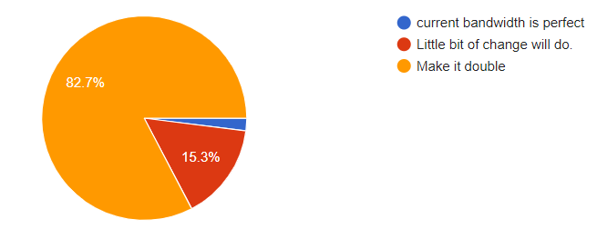
Limitations Of Wi-Fi System (Contd…)
Users’ demand on Wi-Fi system
Fig 05: User response on increasing bandwidth

Slide 10
Proposed System
Introduce payment gateway and different payment methods
Reducing complication of registration system
Introducing app based registration system
Increasing Wi-Fi bandwidth up to double

Slide 11
Updating Registration System
Technical Feasibility
Introducing payment gateway
Make an agreement with a responsible bank to control the whole system

Slide 12
Updating Registration System(Contd…)
Operational Feasibility
An officer will monitor the system
Server maintenance

Slide 13
Updating Registration System(Contd…)
Economical Feasibility
Table 01: Investment on updating registration system
Investment | Cost (Taka)
Signing deal | 30,000
Agreement with responsible bank | 10,00,000
Total Invest | 10,30,000

Slide 14
Updating Registration System(Contd…)
Economical Feasibility
Table 02: Cost per year
Running Cost | Cost (Taka)
Server Maintenance | 1,80,000
Salary increased of responsible employee | 2,40,000
Total Cost | 4,20,000

Slide 15
Updating Registration System (Contd.)
Economical Feasibility
Total Investment 10,30,000
Total Cost (Per Year) 4,20,000
Expected Income 5000*50*2 + 5,00,000 (Budget)
=10,00,000
Net Benefit Expected Income - Total Cost
= 10,00,000 - 4,20,000
= 5,80,000
Payback Period Investment / Net benefit
= 10,30,000 / 5,80,000
= 1.77 years
≈ 1 years 10 months (approx.)

Slide 16
Increasing Wi-Fi Bandwidth
Technical Feasibility
Increase Wi-Fi bandwidth up to double
Increasing and updating device

Slide 17
Increasing Wi-Fi Bandwidth (Contd...)
Operational Feasibility
An officer will monitor the system
Server maintenance
Device maintenance

Slide 18
Increasing Wi-Fi Bandwidth (Contd...)
Economical Feasibility
Table 03: Investment on increasing Wi-Fi bandwidth
Investment | Cost (Taka)
Increasing Bandwidth up to 2GB | 22,00,000
Buying and maintaining device | 14,00,000
Total Cost | 36,00,000

Slide 19
Increasing Wi-Fi Bandwidth (Contd...)
Economical Feasibility
Table 04: Cost per year
Running Cost | Cost (Taka)
Increase in salary of responsive employee | 2,40,000
Server and device maintenance cost | 1,00,000
Total Cost | 3,40,000

Slide 20
Increasing Wi-Fi Bandwidth (Contd...)
Economical Feasibility
Total Investment 36,00,000
Total Cost (Per Year) 3,40,000
Expected Income 50*8000 + 10,00,000 (Budget)
=14,00,000
Net Benefit Expected Income - Total Cost
=14,00,000 - 3,40,000
=10,60,000
Payback Period Investment / Net benefit
=36,00,000 / 10,60,000
=3.396 years
≈ 3 years 5 months (approx.)

Slide 21
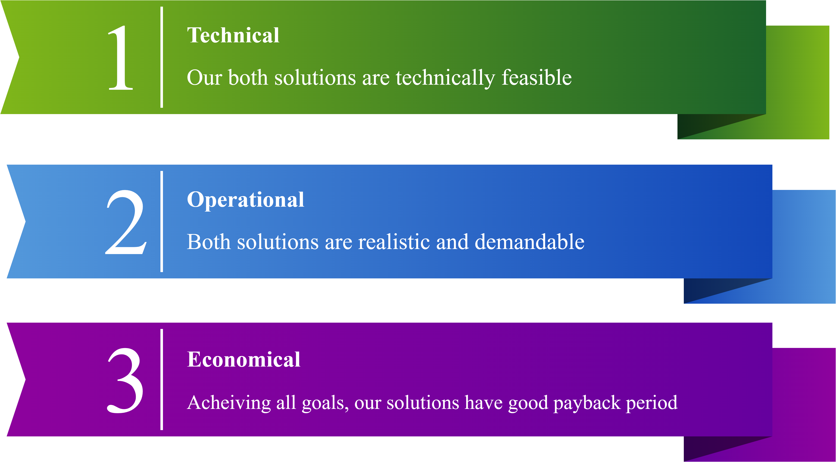
Comparison

Slide 22
Conclusion
Introducing payment gateway is a top demand of CUET students
Updating bandwidth will be crucial for long term

Slide 23
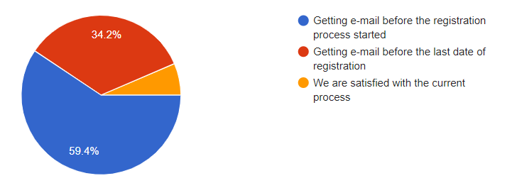
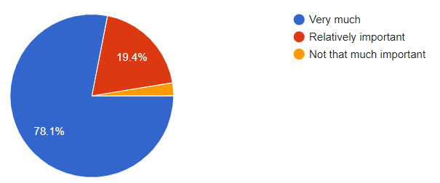
References
Survey Form Link : https://forms.gle/AxMhBQqS47FyeDUQA

Slide 24
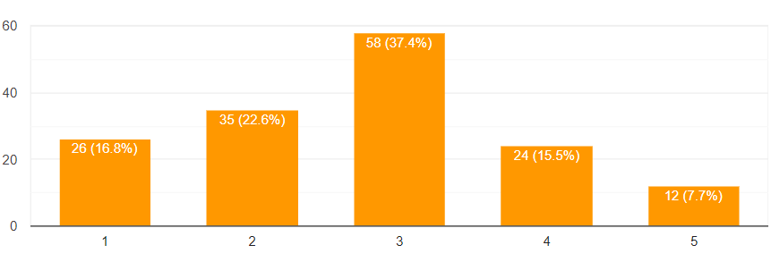
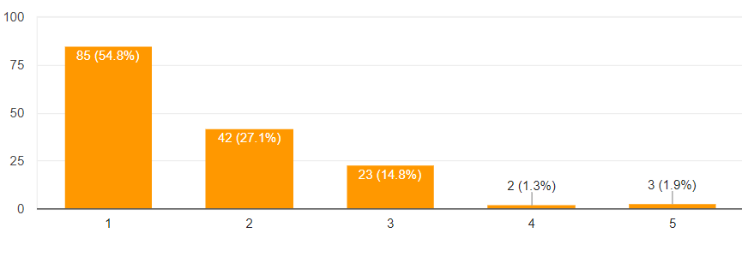
References(Contd…)

Slide 25
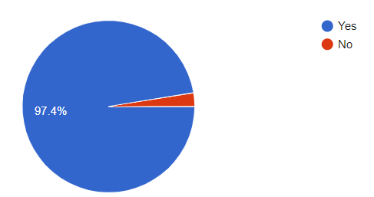
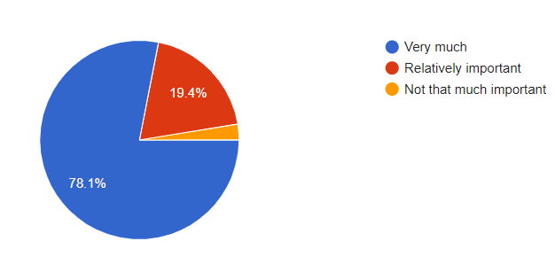
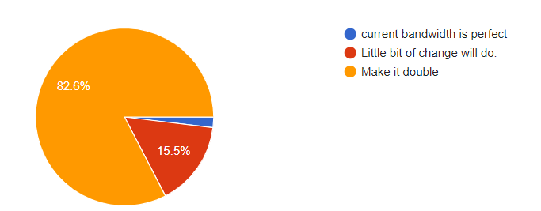
References(Contd…)

Slide 26


